Slide 1
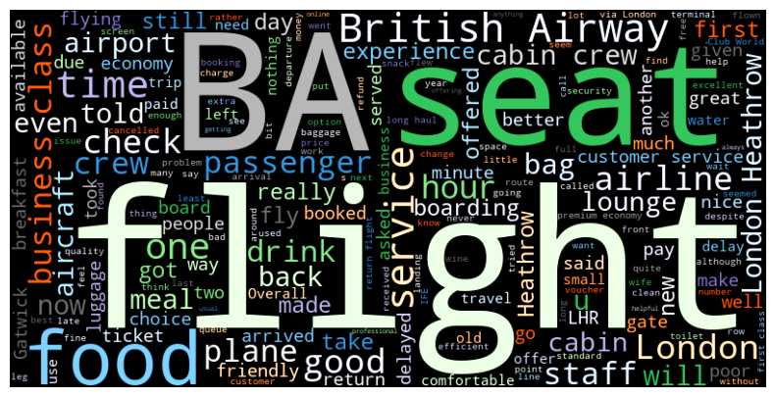
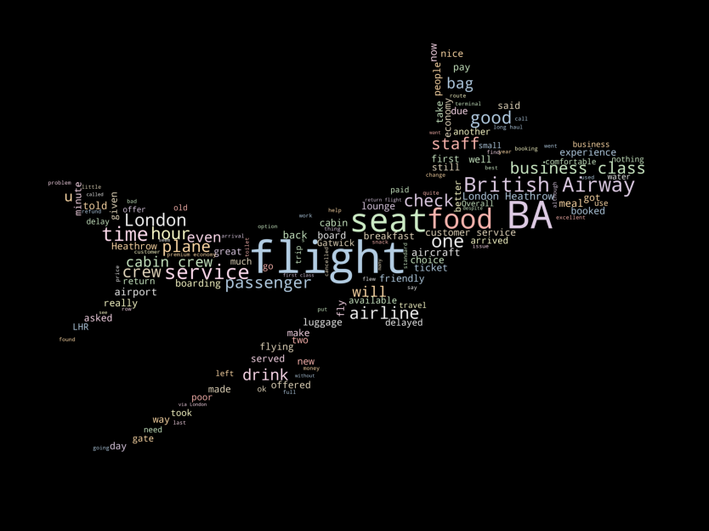
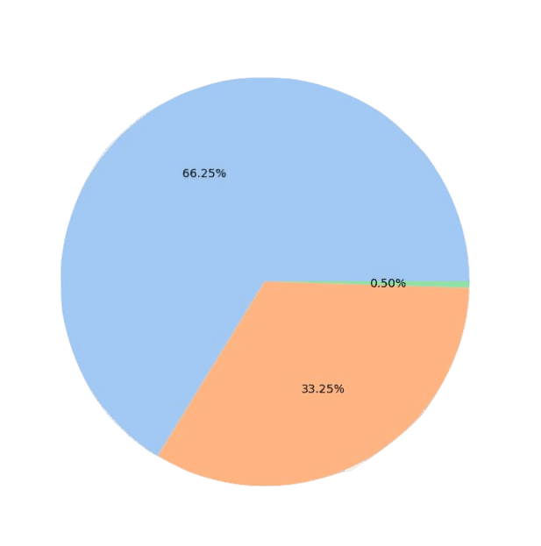
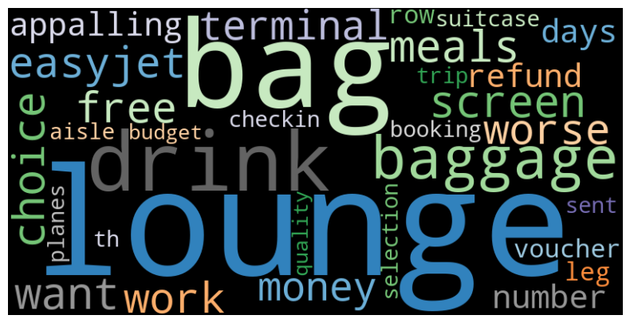
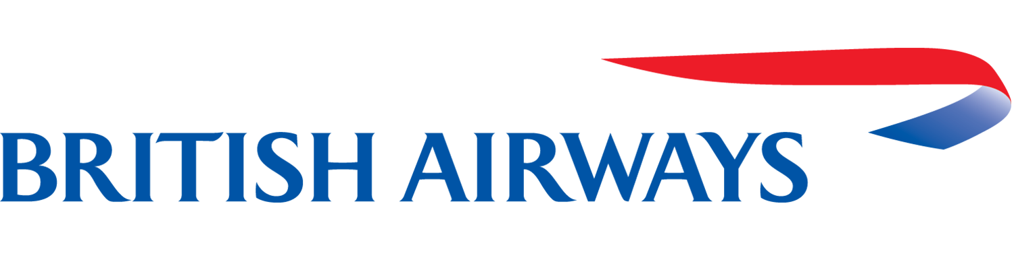
BRITISH AIRWAYS
Review Analysis
2000 reviews were extracted from the website.
Sentiment Analysis was done using TextBlob.
Positive
Neutral
Negative
Negative word cloud
These are the words used in the negative reviews and thus, needs improvement. The company could improve baggage claims, drinks served, lounge access, food etc.
Out of 2000 reviews, 66.25% reviews are positive.
There are more positive reviews and there are very less neutral reviews.

Slide 2
TOPIC MODELING
AND
MOST COMMON WORDS
TOPICS -
1 : times travel ask went bag
2 : dinner tea wine coffee inflight
3 : quite product best bit little
4 : bag refund baggage ticket booking
5 : lhr cape town cancelled said
6 : short haul europe budget free
7 : excellent aisle main efficient fine
8 : screen bad space quality sleep
9 : ticket leg travel extra row
10 : cancelled days checkin tickets help
MOST COMMON WORDS -
service
food
crew
time
class
cabin
seats
good
one
business
staff
would
get
economy
airline
first
back
plane
boarding
passengers
NEGATIVE TOPICS -
screen choice meals want
drinks bag easyjet free
lounge work worse drink
terminal money appalling lounge
days refund number voucher
row leg lounge booking
planes budget lounge quality

